Slide 1
Inheritance
& a brief Introduction to Exception Handling

Slide 2
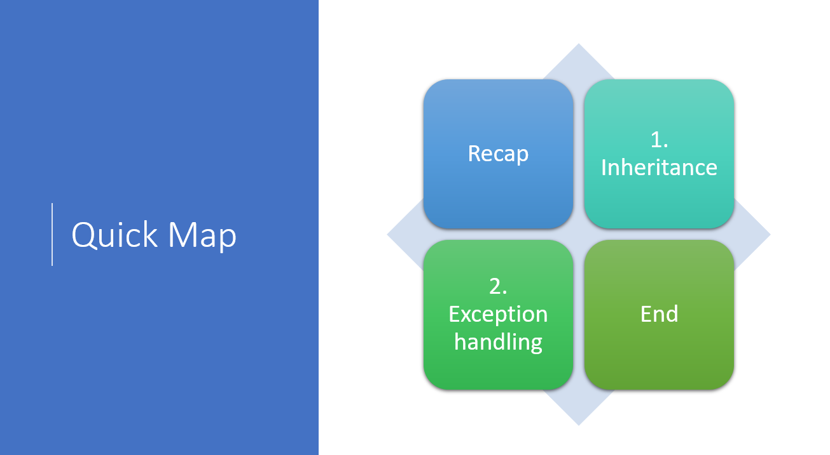

Slide 3
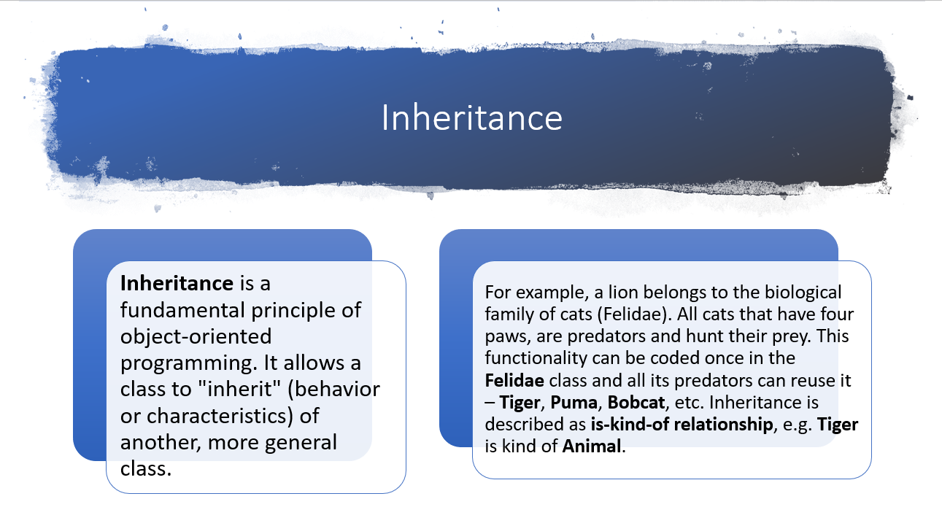

Slide 4
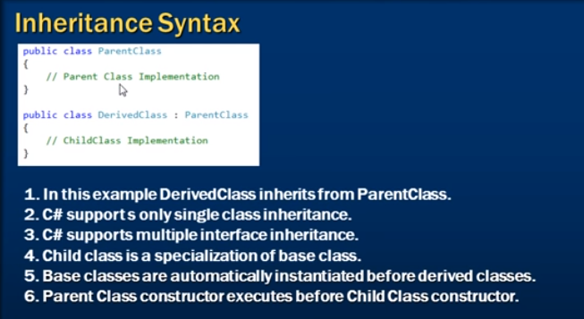

Slide 5

Why inheritance?
Pillars of OOP
Inheritance
Encapsulation
Abstraction
Polymorphism
Primary pillar of OOP.
Allows code reuse.
Code reuse saves on time and reduces errors.

Slide 6
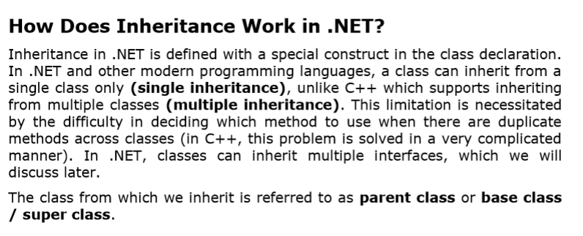

Slide 7
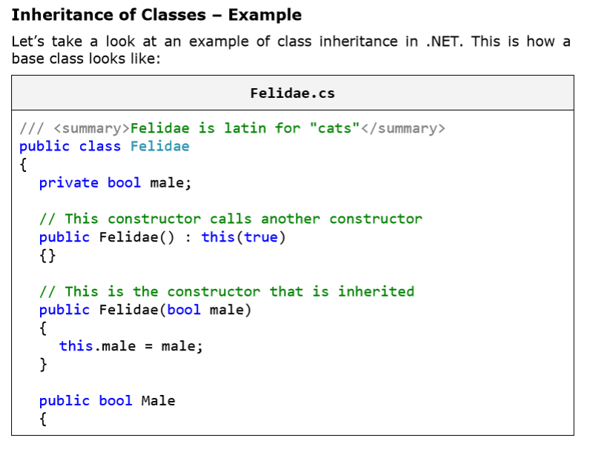

Slide 8
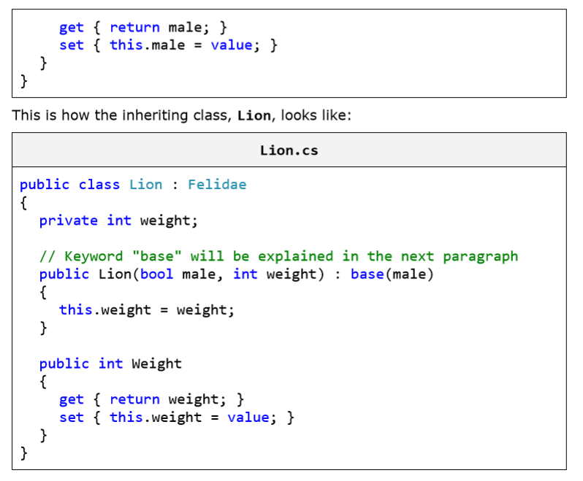

Slide 9
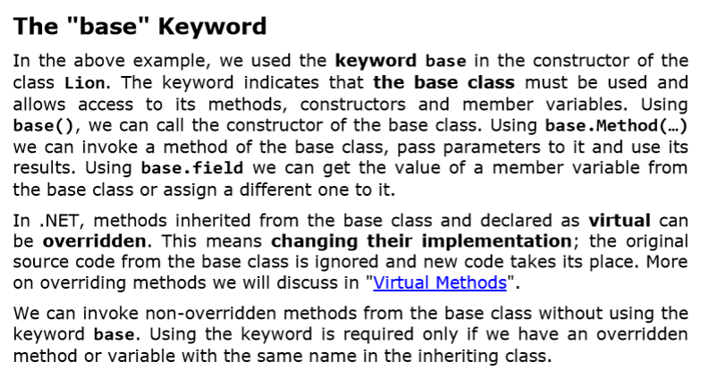

Slide 10
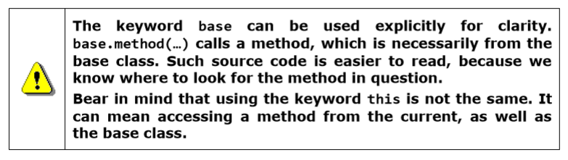

Slide 11
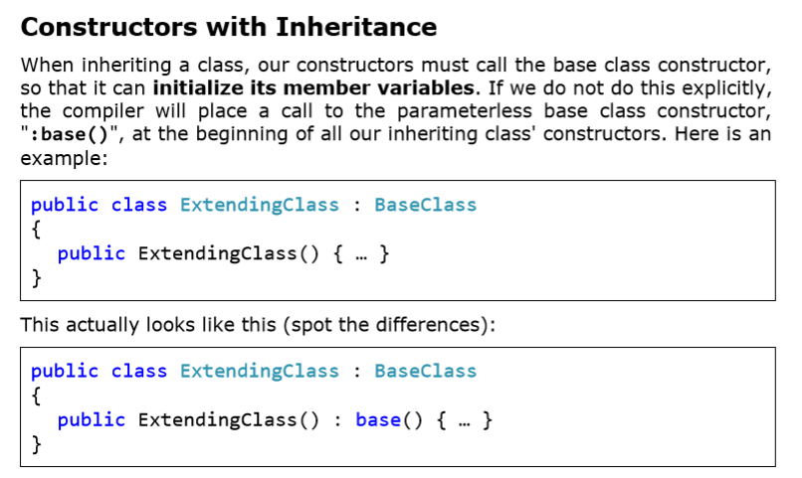

Slide 12
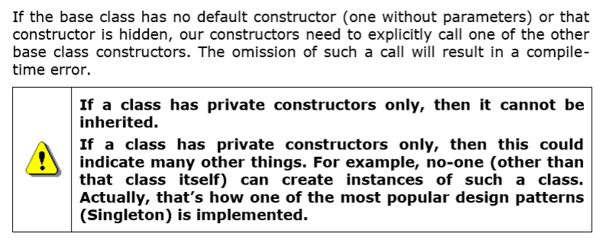

Slide 13
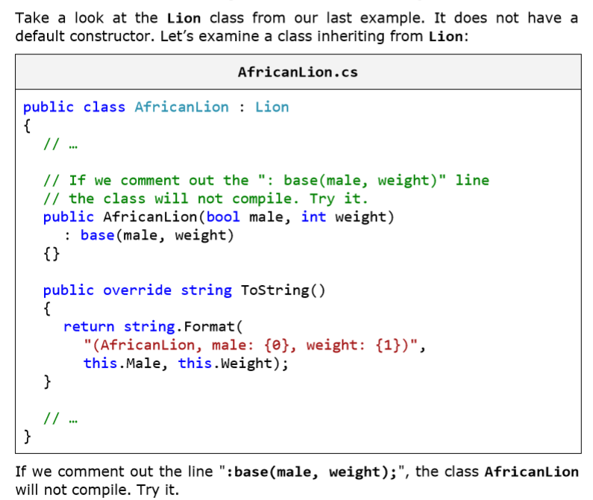
Constructors and the Keyword "base" – Example

Slide 14
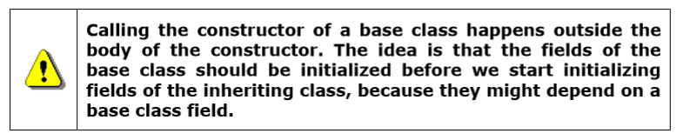

Slide 15
Access Modifiers of Class Members and Inheritance
When a base class is inherited:
- All of its public, protected and protected internal members (methods, properties, etc.) are visible to the inheriting class.
- All of its private methods, properties and member-variables are not visible to the inheriting class.
- All of its internal members are visible to the inheriting class, only if the base class and the inheriting class are in the same assembly (the same Visual Studio project).

Slide 16
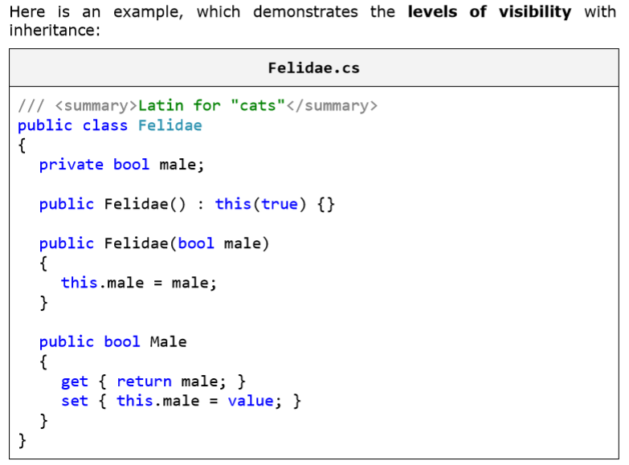

Slide 17
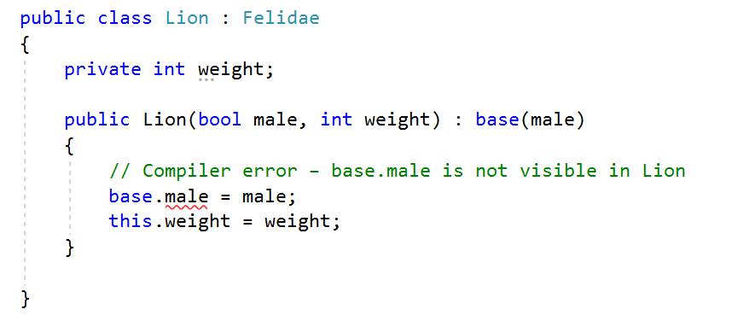
And this is how the class Lion looks like

Slide 18
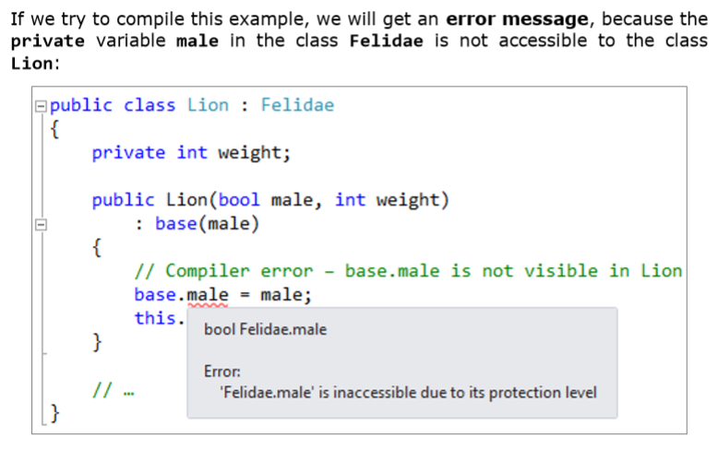

Slide 19
Exception Handling
Just a brief introduction, will be handled exceptionally during the next class.

Slide 20
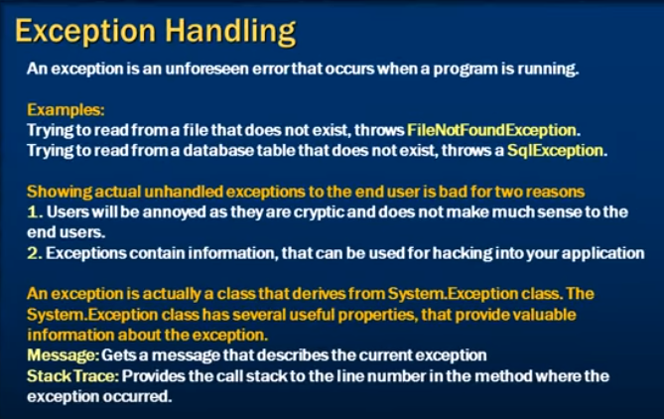

Slide 21
The End
Ooko Emmanuel

